Slide 1
SoftHier Progress Update
Chi Zhang chizhang@iis.ee.ethz.ch

Slide 2
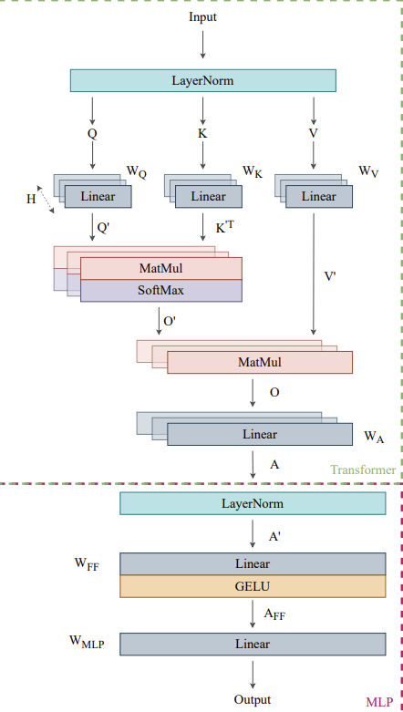
Meeting Update & Potential Meeting Time Rescheduling
We preposed first dataflow schedule of MHA on SoftHier
Data tiling mapping and location in HBM are considered
Only discussing on LLM prompt/prefill stage
Motivating collection operations in NoC
Broadcasting, reduction
For SoftHier Meeting time
Is it possible to hold few times a meeting after 13:30 Zurich time?
Prof. Luca Benini would like to join occasionally from California (US).
Start
End

Slide 3
Workload Description and SoftHier Arch Constraints
E: Embeding Length=4096
Workload Description:
LLama3-70b, INT16/FP16/BF16
in prompt/prefill stage of LLM, batch size=1
No KV Cache discussion here
MHA of each layer (Parameter S,E,H,D)
Assume Input is already normalized
SoftHier Arch Constraints
Squared Mesh: N^2 Clusters
Two HBM Stacks on West and North edge
N channels on each stack
Input
S: Sequence Length<4096
D: Head Dimension = 128
H: Head Number = 32
MHA
Note: E = D*H
Output
S
E
To SYNC NoC Router
To DATA NoC Router
HBM
Infinite Instruction Mem
R
R
R
R
C
C
C
C
CTRL
REG
Core 0
RedMule
iDMA
Core 0
C
C
C
C
…
R
R
R
R
Core n
HBM
Interconnect
C
C
C
C
R
R
R
R
TCDM
C
C
C
C
R
R
R
R
Cluster

Slide 4
Input and Weights Dimension and Location in HBM stack
E
E
D
D
D
Output
Input
W_{q}
W_{q}
W_{q}
W_{q}
W_{q}
W_{q}
W_{k}
W_{k}
W_{k}
W_{k}
W_{k}
W_{k}
W_{v}
W_{v}
W_{v}
W_{v}
W_{v}
W_{v}
For
eachhead………
S
S
E
………
………
D*H
D*H
D*H
Q_proj Weights
K_proj Weights
V_proj Weights
West HBM Stack
North HBM Stack

Slide 5
Input and Weights Tiling Scheme and Layout in HBM channels
Q_proj Weights
E
D
Input
W_{q}
W_{q}
W_{q}
W_{q}
W_{q}
W_{q}
For
eachhead………
S
E
D*H
………
………
………
………
………
………
………
………
………
………
………
………
………
………
………
………
………
………
D
………
W_{q7}
W_{q0}
W_{q7}
W_{q0}
W_{q7}
W_{q0}
W_{q7}
W_{q0}
W_{q7}
W_{q0}
W_{q7}
W_{q0}
W_{q7}
W_{q0}
W_{q7}
W_{q0}
W_{q7}
W_{q0}
I₀₇
I₀₆
I₀₅
I₀₄
I₀₃
I₀₂
I₀₁
I₀₀
W_{q7}
HBM ch 0
………
S/N
W_{q6}
W_{q0}
W_{q6}
W_{q0}
W_{q6}
W_{q0}
W_{q6}
W_{q0}
W_{q6}
W_{q0}
W_{q6}
W_{q0}
W_{q6}
W_{q0}
W_{q6}
W_{q0}
W_{q6}
W_{q0}
W_{q6}
W_{q5}
W_{q0}
W_{q5}
W_{q0}
W_{q5}
W_{q0}
W_{q5}
W_{q0}
W_{q5}
W_{q0}
W_{q5}
W_{q0}
W_{q5}
W_{q0}
W_{q5}
W_{q0}
W_{q5}
W_{q0}
W_{q5}
I₁₇
I₁₆
I₁₅
I₁₄
I₁₃
I₁₂
I₁₁
I₁₀
HBM ch 1
………
W_{q4}
W_{q0}
For
eachhead………
W_{q4}
W_{q0}
W_{q4}
W_{q0}
W_{q4}
W_{q0}
W_{q4}
W_{q0}
W_{q4}
W_{q0}
W_{q4}
W_{q0}
W_{q4}
W_{q0}
W_{q4}
W_{q0}
W_{q4}
W_{q3}
W_{q0}
W_{q3}
W_{q0}
W_{q3}
W_{q0}
W_{q3}
W_{q0}
W_{q3}
W_{q0}
W_{q3}
W_{q0}
W_{q3}
W_{q0}
W_{q3}
W_{q0}
W_{q3}
W_{q0}
W_{q3}
I₂₇
I₂₆
I₂₅
I₂₄
I₂₃
I₂₂
I₂₁
I₂₀
W_{q2}
W_{q0}
W_{q2}
W_{q0}
W_{q2}
W_{q0}
W_{q2}
W_{q0}
W_{q2}
W_{q0}
W_{q2}
W_{q0}
W_{q2}
W_{q0}
W_{q2}
W_{q0}
W_{q2}
W_{q0}
HBM ch 2
………
W_{q2}
W_{q1}
W_{q0}
W_{q1}
W_{q0}
W_{q1}
W_{q0}
W_{q1}
W_{q0}
W_{q1}
W_{q0}
W_{q1}
W_{q0}
W_{q1}
W_{q0}
W_{q1}
W_{q0}
W_{q1}
W_{q0}
W_{q1}
D
W_{q0}
W_{q0}
W_{q0}
W_{q0}
W_{q0}
W_{q0}
W_{q0}
W_{q0}
W_{q0}
W_{q0}
W_{q0}
W_{q0}
W_{q0}
W_{q0}
W_{q0}
W_{q0}
W_{q0}
W_{q0}
I₃₇
I₃₆
I₃₅
I₃₄
I₃₃
I₃₂
I₃₁
I₃₀
W_{q0}
HBM ch N
………
D
E = D * H
HBM
ch 0
HBM
ch 1
HBM
ch 2
HBM
ch N
HBM
ch 0
HBM
ch 1
HBM
ch 2
HBM
ch N
HBM
ch 0
HBM
ch N
West HBM Stack Channels
North HBM Stack Channels

Slide 6
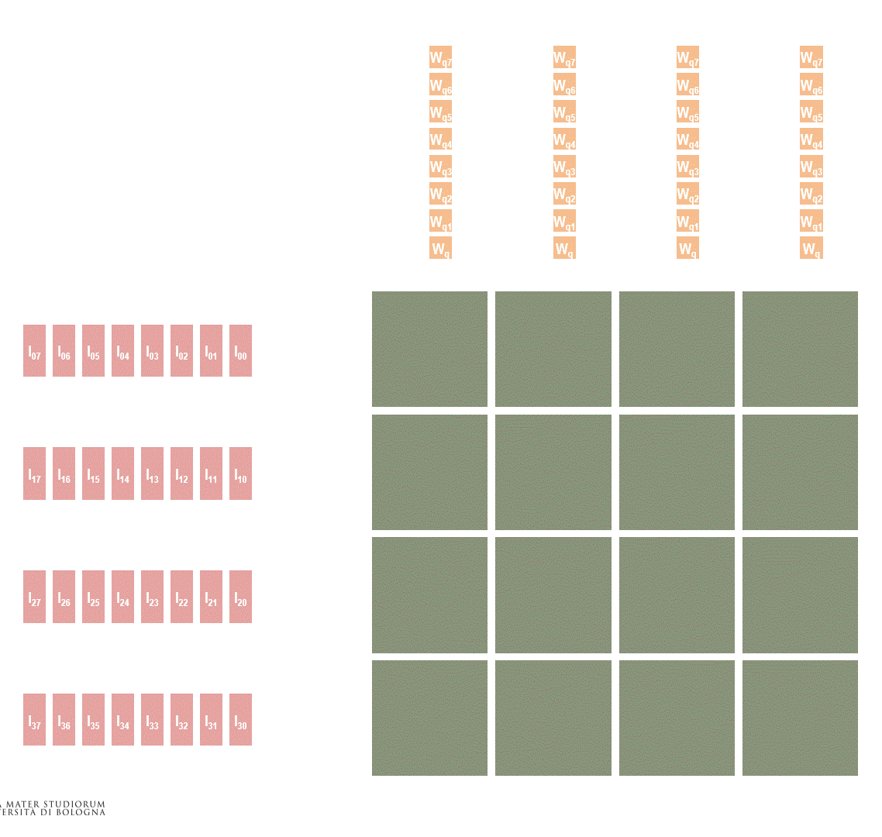
MHA Step1. QKV Projection
…
…
…
…
…
…
QKV Projection is intrinsically MatMul :
Example of program cluster as systolic array
Q_proj (here H=8 for demo)
W_{q3}
W_{q3}
W_{q3}
W_{k3}
W_{k3}
W_{k3}
…
I₀₃
I₀₂
I₀₁
I₀₀
W_{q2}
W_{q2}
…
W_{q2}
W_{k2}
W_{k2}
…
W_{k2}
W_{q1}
W_{q1}
W_{q1}
W_{k1}
W_{k1}
W_{k1}
…
I₁₃
I₁₂
I₁₁
I₁₀
W_{q0}
W_{q0}
W_{q0}
W_{k0}
W_{k0}
W_{k0}
…
I₂₃
I₂₂
I₂₁
I₂₀
…
…
…
W_{v3}
W_{v3}
W_{v3}
…
I₃₃
I₃₂
I₃₁
I₃₀
W_{v2}
W_{v2}
W_{v2}
…
W_{v1}
W_{v1}
W_{v1}
W_{v0}
W_{v0}
W_{v0}
West HBM Stack
North HBM Stack
…
V₀
_{h3}
V₀
_{h2}
V₀
_{h1}
V₀
_{h0}
…
Q₀
_{h3}
Q₀
_{h2}
Q₀
_{h1}
Q₀
_{h0}
K₃
_{h0}
K₃
_{h1}
K₃
_{h2}
K₃
_{h3}
…
…
V₁
_{h3}
V₁
_{h2}
V₁
_{h1}
V₁
_{h0}
…
Q₁
_{h3}
Q₁
_{h2}
Q₁
_{h1}
Q₁
_{h0}
K₂
_{h0}
K₂
_{h1}
K₂
_{h2}
K₂
_{h3}
…
…
V₂
_{h3}
V₂
_{h2}
V₂
_{h1}
V₂
_{h0}
…
Q₂
_{h3}
Q₂
_{h2}
Q₂
_{h1}
Q₂
_{h0}
K₁
_{h0}
K₁
_{h1}
K₁
_{h2}
K₁
_{h3}
…
…
V₃
_{h3}
V₃
_{h2}
V₃
_{h1}
V₃
_{h0}
…
Q₃
_{h3}
Q₃
_{h2}
Q₃
_{h1}
Q₃
_{h0}
K₀
_{h0}
K₀
_{h1}
K₀
_{h2}
K₀
_{h3}
…

Slide 7

How you do Attention
FlashAttention on each cluster for each head
FlattenAttention: All Cluster for one head
_{For Head 0}
_{For Head 1}
_{For Head 2}
_{For Head 3}
_{For Head 0}
_{Attention}
_{tile 00}
_{For Head 0}
_{Attention}
_{tile 01}
_{For Head 0}
_{Attention}
_{tile 02}
_{For Head 0}
_{Attention}
_{tile 03}
_{For Head 4}
_{For Head 5}
_{For Head 6}
_{For Head 7}
_{For Head 0}
_{Attention}
_{tile 10}
_{For Head 0}
_{Attention}
_{tile 11}
_{For Head 0}
_{Attention}
_{tile 12}
_{For Head 0}
_{Attention}
_{tile 13}
_{For Head 8}
_{For Head 9}
_{For Head 10}
_{For Head 11}
_{For Head 0}
_{Attention}
_{tile 20}
_{For Head 0}
_{Attention}
_{tile 21}
_{For Head 0}
_{Attention}
_{tile 22}
_{For Head 0}
_{Attention}
_{tile 23}
_{For Head 12}
_{For Head 13}
_{For Head 14}
_{For Head 15}
_{For Head 0}
_{Attention}
_{tile 30}
_{For Head 0}
_{Attention}
_{tile 31}
_{For Head 0}
_{Attention}
_{tile 32}
_{For Head 0}
_{Attention}
_{tile 33}
M=Cluster L1
M=#Cluster * Cluster L1
Let 𝑁 be the sequence length, 𝑑 be the head dimension, and 𝑀 be size of SRAM. FlashAttention

Slide 8
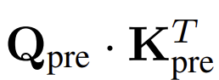
MHA Step2. QK Matmul
K₃
_{h0}
K₃
_{h1}
K₃
_{h2}
K₃
_{h3}
K₂
_{h0}
K₂
_{h1}
K₂
_{h2}
K₂
_{h3}
Note
After QKV projection, following steps focus only on one head and we process every head sequentially
K₁
_{h0}
K₁
_{h1}
K₁
_{h2}
K₁
_{h3}
K₀
_{h0}
K₀
_{h1}
K₀
_{h2}
K₀
_{h3}
V₀
_{h3}
V₀
_{h2}
V₀
_{h1}
V₀
_{h0}
Q₀
_{h3}
Q₀
_{h2}
Q₀
_{h1}
Q₀
_{h0}
V₁
_{h3}
V₁
_{h2}
V₁
_{h1}
V₁
_{h0}
Q₁
_{h3}
Q₁
_{h2}
Q₁
_{h1}
Q₁
_{h0}
V₂
_{h3}
V₂
_{h2}
V₂
_{h1}
V₂
_{h0}
Q₂
_{h3}
Q₂
_{h2}
Q₂
_{h1}
Q₂
_{h0}
V₃
_{h3}
V₃
_{h2}
V₃
_{h1}
V₃
_{h0}
Q₃
_{h3}
Q₃
_{h2}
Q₃
_{h1}
Q₃
_{h0}

Slide 9
MHA Step2. QK Matmul
K₃
_{h0}
K₃
_{h1}
K₃
_{h2}
K₃
_{h3}
K₂
_{h0}
K₂
_{h1}
K₂
_{h2}
K₂
_{h3}
Note
Load and row-wise broadcast Q_{pre} of Head0
K₁
_{h0}
K₁
_{h1}
K₁
_{h2}
K₁
_{h3}
K₀
_{h0}
K₀
_{h1}
K₀
_{h2}
K₀
_{h3}
Q₀
_{h0}
Q₀
_{h0}
Q₀
_{h0}
V₀
_{h3}
V₀
_{h2}
V₀
_{h1}
V₀
_{h0}
Q₀
_{h3}
Q₀
_{h2}
Q₀
_{h1}
Q₀
_{h0}
Q₁
_{h0}
Q₁
_{h0}
Q₁
_{h0}
V₁
_{h3}
V₁
_{h2}
V₁
_{h1}
V₁
_{h0}
Q₁
_{h3}
Q₁
_{h2}
Q₁
_{h1}
Q₁
_{h0}
V₂
_{h3}
Q₂
_{h3}
Q₂
_{h0}
Q₂
_{h0}
Q₂
_{h0}
V₂
_{h2}
V₂
_{h1}
V₂
_{h0}
Q₂
_{h2}
Q₂
_{h1}
Q₂
_{h0}
Q₃
_{h0}
Q₃
_{h0}
Q₃
_{h0}
V₃
_{h3}
V₃
_{h2}
V₃
_{h1}
V₃
_{h0}
Q₃
_{h3}
Q₃
_{h2}
Q₃
_{h1}
Q₃
_{h0}

Slide 10
MHA Step2. QK Matmul
K₃
_{h0}
K₃
_{h1}
K₃
_{h2}
K₃
_{h3}
K₂
_{h0}
K₂
_{h1}
K₂
_{h2}
K₂
_{h3}
Note
Load and row-wise broadcast Q_{pre} of Head0
K₁
_{h0}
K₁
_{h1}
K₁
_{h2}
K₁
_{h3}
row-wise broadcast
K₀
_{h0}
K₀
_{h1}
K₀
_{h2}
K₀
_{h3}
V₀
_{h3}
V₀
_{h2}
V₀
_{h1}
V₀
_{h0}
Q₀
_{h3}
Q₀
_{h2}
Q₀
_{h1}
Q₀
_{h0}
Q₀
_{h0}
Q₀
_{h0}
Q₀
_{h0}
V₁
_{h3}
V₁
_{h2}
V₁
_{h1}
V₁
_{h0}
Q₁
_{h3}
Q₁
_{h2}
Q₁
_{h1}
Q₁
_{h0}
Q₁
_{h0}
Q₁
_{h0}
Q₁
_{h0}
V₂
_{h3}
V₂
_{h2}
V₂
_{h1}
V₂
_{h0}
Q₂
_{h3}
Q₂
_{h2}
Q₂
_{h1}
Q₂
_{h0}
Q₂
_{h0}
Q₂
_{h0}
Q₂
_{h0}
V₃
_{h3}
V₃
_{h2}
V₃
_{h1}
V₃
_{h0}
Q₃
_{h3}
Q₃
_{h2}
Q₃
_{h1}
Q₃
_{h0}
Q₃
_{h0}
Q₃
_{h0}
Q₃
_{h0}

Slide 11
MHA Step2. QK Matmul
K₃
_{h1}
K₃
_{h2}
K₃
_{h3}
K₂
_{h1}
K₂
_{h2}
K₂
_{h3}
Note
Load and column-wise broadcast K_{pre} of Head0
K₁
_{h1}
K₁
_{h2}
K₁
_{h3}
K₀
_{h1}
K₀
_{h2}
K₀
_{h3}
Q₀
_{h0}
K₀
_{h0}
K₀
_{h0}
K₀
_{h0}
K₀
_{h0}
Q₀
_{h0}
K₁
_{h0}
K₁
_{h0}
K₁
_{h0}
K₁
_{h0}
Q₀
_{h0}
K₂
_{h0}
K₂
_{h0}
K₂
_{h0}
K₂
_{h0}
Q₀
_{h0}
K₃
_{h0}
K₃
_{h0}
K₃
_{h0}
V₀
_{h3}
V₀
_{h2}
V₀
_{h1}
V₀
_{h0}
Q₀
_{h3}
Q₀
_{h2}
Q₀
_{h1}
K₃
_{h0}
V₁
_{h3}
V₁
_{h2}
V₁
_{h1}
V₁
_{h0}
Q₁
_{h3}
Q₁
_{h2}
Q₁
_{h1}
Q₁
_{h0}
Q₁
_{h0}
Q₁
_{h0}
Q₁
_{h0}
V₂
_{h3}
V₂
_{h2}
V₂
_{h1}
V₂
_{h0}
Q₂
_{h3}
Q₂
_{h2}
Q₂
_{h1}
Q₂
_{h0}
Q₂
_{h0}
Q₂
_{h0}
Q₂
_{h0}
V₃
_{h3}
V₃
_{h2}
V₃
_{h1}
V₃
_{h0}
Q₃
_{h3}
Q₃
_{h2}
Q₃
_{h1}
Q₃
_{h0}
Q₃
_{h0}
Q₃
_{h0}
Q₃
_{h0}

Slide 12
MHA Step2. QK Matmul
K₃
_{h1}
K₃
_{h2}
K₃
_{h3}
K₂
_{h1}
K₂
_{h2}
K₂
_{h3}
Note
Load and column-wise broadcast K_{pre} of Head0
K₁
_{h1}
K₁
_{h2}
K₁
_{h3}
column-wise broadcast
K₀
_{h1}
K₀
_{h2}
K₀
_{h3}
V₀
_{h3}
V₀
_{h2}
V₀
_{h1}
V₀
_{h0}
Q₀
_{h3}
Q₀
_{h2}
Q₀
_{h1}
Q₀
_{h0}
K₀
_{h0}
Q₀
_{h0}
K₁
_{h0}
Q₀
_{h0}
K₂
_{h0}
Q₀
_{h0}
K₃
_{h0}
V₁
_{h3}
V₁
_{h2}
V₁
_{h1}
V₁
_{h0}
Q₁
_{h3}
Q₁
_{h2}
Q₁
_{h1}
Q₁
_{h0}
K₀
_{h0}
Q₁
_{h0}
K₁
_{h0}
Q₁
_{h0}
K₂
_{h0}
Q₁
_{h0}
K₃
_{h0}
V₂
_{h3}
V₂
_{h2}
V₂
_{h1}
V₂
_{h0}
Q₂
_{h3}
Q₂
_{h2}
Q₂
_{h1}
Q₂
_{h0}
K₀
_{h0}
Q₂
_{h0}
K₁
_{h0}
Q₂
_{h0}
K₂
_{h0}
Q₂
_{h0}
K₃
_{h0}
V₃
_{h3}
V₃
_{h2}
V₃
_{h1}
V₃
_{h0}
Q₃
_{h3}
Q₃
_{h2}
Q₃
_{h1}
Q₃
_{h0}
K₀
_{h0}
Q₃
_{h0}
K₁
_{h0}
Q₃
_{h0}
K₂
_{h0}
Q₃
_{h0}
K₃
_{h0}

Slide 13
MHA Step2. QK Matmul
K₃
_{h1}
K₃
_{h2}
K₃
_{h3}
K₂
_{h1}
K₂
_{h2}
K₂
_{h3}
Note
Transpose K_{pre} tiles in each cluster
K₁
_{h1}
K₁
_{h2}
K₁
_{h3}
K₀
_{h1}
K₀
_{h2}
K₀
_{h3}
K₀
_{h0}
K₁
_{h0}
K₂
_{h0}
K₃
_{h0}
V₀
_{h3}
V₀
_{h2}
V₀
_{h1}
V₀
_{h0}
Q₀
_{h3}
Q₀
_{h2}
Q₀
_{h1}
Q₀
_{h0}
Q₀
_{h0}
Q₀
_{h0}
Q₀
_{h0}
K₀
_{h0}
K₁
_{h0}
K₂
_{h0}
K₃
_{h0}
V₁
_{h3}
V₁
_{h2}
V₁
_{h1}
V₁
_{h0}
Q₁
_{h3}
Q₁
_{h2}
Q₁
_{h1}
Q₁
_{h0}
Q₁
_{h0}
Q₁
_{h0}
Q₁
_{h0}
K₀
_{h0}
K₁
_{h0}
K₂
_{h0}
K₃
_{h0}
V₂
_{h3}
V₂
_{h2}
V₂
_{h1}
V₂
_{h0}
Q₂
_{h3}
Q₂
_{h2}
Q₂
_{h1}
Q₂
_{h0}
Q₂
_{h0}
Q₂
_{h0}
Q₂
_{h0}
K₀
_{h0}
K₁
_{h0}
K₂
_{h0}
K₃
_{h0}
V₃
_{h3}
V₃
_{h2}
V₃
_{h1}
V₃
_{h0}
Q₃
_{h3}
Q₃
_{h2}
Q₃
_{h1}
Q₃
_{h0}
Q₃
_{h0}
Q₃
_{h0}
Q₃
_{h0}

Slide 14
MHA Step2. QK Matmul
K₃
_{h1}
K₃
_{h2}
K₃
_{h3}
K₂
_{h1}
K₂
_{h2}
K₂
_{h3}
Note
MatMal (Q_{pre} * K^{T}_{pre}) compute attention matrix tiles of Head0 in each cluster
K₁
_{h1}
K₁
_{h2}
K₁
_{h3}
K₀
_{h1}
K₀
_{h2}
K₀
_{h3}
K₀
_{h0}
K₁
_{h0}
K₂
_{h0}
K₃
_{h0}
V₀
_{h3}
V₀
_{h2}
V₀
_{h1}
V₀
_{h0}
Q₀
_{h3}
Q₀
_{h2}
Q₀
_{h1}
Q₀
_{h0}
Att₀₀
Q₀
_{h0}
Att₀₁
Q₀
_{h0}
Att₀₂
Q₀
_{h0}
Att₀₃
K₀
_{h0}
K₁
_{h0}
K₂
_{h0}
K₃
_{h0}
V₁
_{h3}
V₁
_{h2}
V₁
_{h1}
V₁
_{h0}
Q₁
_{h3}
Q₁
_{h2}
Q₁
_{h1}
Q₁
_{h0}
Att₁₀
Q₁
_{h0}
Att₀₁
Q₁
_{h0}
Att₁₂
Q₁
_{h0}
Att₁₃
K₀
_{h0}
K₁
_{h0}
K₂
_{h0}
K₃
_{h0}
V₂
_{h3}
V₂
_{h2}
V₂
_{h1}
V₂
_{h0}
Q₂
_{h3}
Q₂
_{h2}
Q₂
_{h1}
Q₂
_{h0}
Att₂₀
Q₂
_{h0}
Att₂₁
Q₂
_{h0}
Att₂₂
Q₂
_{h0}
Att₂₃
K₀
_{h0}
K₁
_{h0}
K₂
_{h0}
K₃
_{h0}
V₃
_{h3}
V₃
_{h2}
V₃
_{h1}
V₃
_{h0}
Q₃
_{h3}
Q₃
_{h2}
Q₃
_{h1}
Q₃
_{h0}
Att₃₀
Q₃
_{h0}
Att₃₁
Q₃
_{h0}
Att₃₂
Q₃
_{h0}
Att₃₃

Slide 15
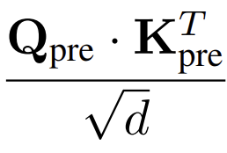
MHA Step3. Scaling
K₃
_{h1}
K₃
_{h2}
K₃
_{h3}
K₂
_{h1}
K₂
_{h2}
K₂
_{h3}
Note
Element-wise division on attention matrix
K₁
_{h1}
K₁
_{h2}
K₁
_{h3}
K₀
_{h1}
K₀
_{h2}
K₀
_{h3}
V₀
_{h3}
V₀
_{h2}
V₀
_{h1}
V₀
_{h0}
Q₀
_{h3}
Q₀
_{h2}
Q₀
_{h1}
Att₀₀
Att₀₁
Att₀₂
Att₀₃
V₁
_{h3}
V₁
_{h2}
V₁
_{h1}
V₁
_{h0}
Q₁
_{h3}
Q₁
_{h2}
Q₁
_{h1}
Att₁₀
Att₀₁
Att₁₂
Att₁₃
V₂
_{h3}
V₂
_{h2}
V₂
_{h1}
V₂
_{h0}
Q₂
_{h3}
Q₂
_{h2}
Q₂
_{h1}
Att₂₀
Att₂₁
Att₂₂
Att₂₃
V₃
_{h3}
V₃
_{h2}
V₃
_{h1}
V₃
_{h0}
Q₃
_{h3}
Q₃
_{h2}
Q₃
_{h1}
Att₃₀
Att₃₁
Att₃₂
Att₃₃

Slide 16
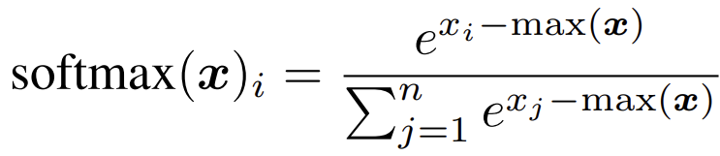
MHA Step4. SoftMax
K₃
_{h1}
K₃
_{h2}
K₃
_{h3}
K₂
_{h1}
K₂
_{h2}
K₂
_{h3}
Note
Each cluster calculates their local partial max(x)
K₁
_{h1}
K₁
_{h2}
K₁
_{h3}
K₀
_{h1}
K₀
_{h2}
K₀
_{h3}
Max_{L}
Max_{L}
Max_{L}
Max_{L}
V₀
_{h3}
V₀
_{h2}
V₀
_{h1}
V₀
_{h0}
Q₀
_{h3}
Q₀
_{h2}
Q₀
_{h1}
Att₀₀
Att₀₁
Att₀₂
Att₀₃
Max_{L}
Max_{L}
Max_{L}
Max_{L}
V₁
_{h3}
V₁
_{h2}
V₁
_{h1}
V₁
_{h0}
Q₁
_{h3}
Q₁
_{h2}
Q₁
_{h1}
Att₁₀
Att₀₁
Att₁₂
Att₁₃
Max_{L}
Max_{L}
Max_{L}
Max_{L}
V₂
_{h3}
V₂
_{h2}
V₂
_{h1}
V₂
_{h0}
Q₂
_{h3}
Q₂
_{h2}
Q₂
_{h1}
Att₂₀
Att₂₁
Att₂₂
Att₂₃
Max_{L}
Max_{L}
Max_{L}
Max_{L}
V₃
_{h3}
V₃
_{h2}
V₃
_{h1}
V₃
_{h0}
Q₃
_{h3}
Q₃
_{h2}
Q₃
_{h1}
Att₃₀
Att₃₁
Att₃₂
Att₃₃

Slide 17
MHA Step4. SoftMax
K₃
_{h1}
K₃
_{h2}
K₃
_{h3}
K₂
_{h1}
K₂
_{h2}
K₂
_{h3}
Note
Row-wise reduction of local partial max(x) to get real max(x)
K₁
_{h1}
K₁
_{h2}
K₁
_{h3}
row-wise reduction
K₀
_{h1}
K₀
_{h2}
K₀
_{h3}
Max_{L}
Max_{L}
Max_{L}
Max_{L}
Max
V₀
_{h3}
V₀
_{h2}
V₀
_{h1}
V₀
_{h0}
Q₀
_{h3}
Q₀
_{h2}
Q₀
_{h1}
Att₀₀
Att₀₁
Att₀₂
Att₀₃
Max_{L}
Max_{L}
Max_{L}
Max_{L}
Max
V₁
_{h3}
V₁
_{h2}
V₁
_{h1}
V₁
_{h0}
Q₁
_{h3}
Q₁
_{h2}
Q₁
_{h1}
Att₁₀
Att₀₁
Att₁₂
Att₁₃
Max_{L}
Max_{L}
Max_{L}
Max_{L}
Max
V₂
_{h3}
V₂
_{h2}
V₂
_{h1}
V₂
_{h0}
Q₂
_{h3}
Q₂
_{h2}
Q₂
_{h1}
Att₂₀
Att₂₁
Att₂₂
Att₂₃
Max_{L}
Max_{L}
Max_{L}
Max_{L}
Max
V₃
_{h3}
V₃
_{h2}
V₃
_{h1}
V₃
_{h0}
Q₃
_{h3}
Q₃
_{h2}
Q₃
_{h1}
Att₃₀
Att₃₁
Att₃₂
Att₃₃

Slide 18
MHA Step4. SoftMax
K₃
_{h1}
K₃
_{h2}
K₃
_{h3}
K₂
_{h1}
K₂
_{h2}
K₂
_{h3}
Note
Row-wise broadcast real max(x) to each cluster
K₁
_{h1}
K₁
_{h2}
K₁
_{h3}
row-wise broadcast
K₀
_{h1}
K₀
_{h2}
K₀
_{h3}
Max
Max
Max
Max
V₀
_{h3}
V₀
_{h2}
V₀
_{h1}
V₀
_{h0}
Q₀
_{h3}
Q₀
_{h2}
Q₀
_{h1}
Att₀₀
Att₀₁
Att₀₂
Att₀₃
Max
Max
Max
Max
V₁
_{h3}
V₁
_{h2}
V₁
_{h1}
V₁
_{h0}
Q₁
_{h3}
Q₁
_{h2}
Q₁
_{h1}
Att₁₀
Att₀₁
Att₁₂
Att₁₃
Max
Max
Max
Max
V₂
_{h3}
V₂
_{h2}
V₂
_{h1}
V₂
_{h0}
Q₂
_{h3}
Q₂
_{h2}
Q₂
_{h1}
Att₂₀
Att₂₁
Att₂₂
Att₂₃
Max
Max
Max
Max
V₃
_{h3}
V₃
_{h2}
V₃
_{h1}
V₃
_{h0}
Q₃
_{h3}
Q₃
_{h2}
Q₃
_{h1}
Att₃₀
Att₃₁
Att₃₂
Att₃₃

Slide 19
MHA Step4. SoftMax
K₃
_{h1}
K₃
_{h2}
K₃
_{h3}
Note
Do the same reduction and broadcast for 𝚺𝒆𝒙𝒑(𝒙_𝒊−𝒎𝒂𝒙(𝒙))
Finally finish SoftMax operation on local attention matrix tile of each cluster
K₂
_{h1}
K₂
_{h2}
K₂
_{h3}
K₁
_{h1}
K₁
_{h2}
K₁
_{h3}
K₀
_{h1}
K₀
_{h2}
K₀
_{h3}
$$Σexp(x_{i}−max)$$
$$Σexp(x_{i}−max)$$
$$Σexp(x_{i}−max)$$
$$Σexp(x_{i}−max)$$
V₀
_{h3}
V₀
_{h2}
V₀
_{h1}
V₀
_{h0}
Q₀
_{h3}
Q₀
_{h2}
Q₀
_{h1}
Att₀₀
Att₀₁
Att₀₂
Att₀₃
$$Σexp(x_{i}−max)$$
$$Σexp(x_{i}−max)$$
$$Σexp(x_{i}−max)$$
$$Σexp(x_{i}−max)$$
V₁
_{h3}
V₁
_{h2}
V₁
_{h1}
V₁
_{h0}
Q₁
_{h3}
Q₁
_{h2}
Q₁
_{h1}
Att₁₀
Att₀₁
Att₁₂
Att₁₃
$$Σexp(x_{i}−max)$$
$$Σexp(x_{i}−max)$$
$$Σexp(x_{i}−max)$$
$$Σexp(x_{i}−max)$$
V₂
_{h3}
V₂
_{h2}
V₂
_{h1}
V₂
_{h0}
Q₂
_{h3}
Q₂
_{h2}
Q₂
_{h1}
Att₂₀
Att₂₁
Att₂₂
Att₂₃
$$Σexp(x_{i}−max)$$
$$Σexp(x_{i}−max)$$
$$Σexp(x_{i}−max)$$
$$Σexp(x_{i}−max)$$
V₃
_{h3}
V₃
_{h2}
V₃
_{h1}
V₃
_{h0}
Q₃
_{h3}
Q₃
_{h2}
Q₃
_{h1}
Att₃₀
Att₃₁
Att₃₂
Att₃₃

Slide 20
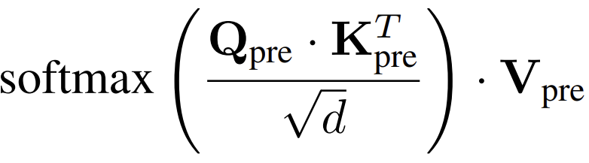
MHA Step5. SV Matmul
K₃
_{h1}
K₃
_{h2}
K₃
_{h3}
K₂
_{h1}
K₂
_{h2}
K₂
_{h3}
Note
Load and row-wise broadcast V_{pre} of Head0
K₁
_{h1}
K₁
_{h2}
K₁
_{h3}
K₀
_{h1}
K₀
_{h2}
K₀
_{h3}
V₀
_{h3}
V₀
_{h2}
V₀
_{h1}
Q₀
_{h3}
Q₀
_{h2}
Q₀
_{h1}
Att₀₀
V₀
_{h0}
Att₀₁
Att₀₂
Att₀₃
V₁
_{h3}
V₁
_{h2}
V₁
_{h1}
Q₁
_{h3}
Q₁
_{h2}
Q₁
_{h1}
Att₁₀
V₁
_{h0}
Att₀₁
Att₁₂
Att₁₃
V₂
_{h3}
V₂
_{h2}
V₂
_{h1}
Q₂
_{h3}
Q₂
_{h2}
Q₂
_{h1}
Att₂₀
V₂
_{h0}
Att₂₁
Att₂₂
Att₂₃
V₃
_{h3}
V₃
_{h2}
V₃
_{h1}
Q₃
_{h3}
Q₃
_{h2}
Q₃
_{h1}
Att₃₀
V₃
_{h0}
Att₃₁
Att₃₂
Att₃₃

Slide 21
MHA Step5. SV Matmul
K₃
_{h1}
K₃
_{h2}
K₃
_{h3}
K₂
_{h1}
K₂
_{h2}
K₂
_{h3}
Note
Load and row-wise broadcast V_{pre} of Head0
K₁
_{h1}
K₁
_{h2}
K₁
_{h3}
row-wise broadcast
K₀
_{h1}
K₀
_{h2}
K₀
_{h3}
V₀
_{h3}
V₀
_{h2}
V₀
_{h1}
Q₀
_{h3}
Q₀
_{h2}
Q₀
_{h1}
Att₀₀
V₀
_{h0}
Att₀₁
V₀
_{h0}
Att₀₂
V₀
_{h0}
Att₀₃
V₀
_{h0}
V₁
_{h3}
V₁
_{h2}
V₁
_{h1}
Q₁
_{h3}
Q₁
_{h2}
Q₁
_{h1}
Att₁₀
V₁
_{h0}
Att₀₁
V₁
_{h0}
Att₁₂
V₁
_{h0}
Att₁₃
V₁
_{h0}
V₂
_{h3}
V₂
_{h2}
V₂
_{h1}
Q₂
_{h3}
Q₂
_{h2}
Q₂
_{h1}
Att₂₀
V₂
_{h0}
Att₂₁
V₂
_{h0}
Att₂₂
V₂
_{h0}
Att₂₃
V₂
_{h0}
V₃
_{h3}
V₃
_{h2}
V₃
_{h1}
Q₃
_{h3}
Q₃
_{h2}
Q₃
_{h1}
Att₃₀
V₃
_{h0}
Att₃₁
V₃
_{h0}
Att₃₂
V₃
_{h0}
Att₃₃
V₃
_{h0}

Slide 22
MHA Step5. SV Matmul
K₃
_{h1}
K₃
_{h2}
K₃
_{h3}
K₂
_{h1}
K₂
_{h2}
K₂
_{h3}
Note
Each cluster calculate partial result of output
K₁
_{h1}
K₁
_{h2}
K₁
_{h3}
K₀
_{h1}
K₀
_{h2}
K₀
_{h3}
V₀
_{h3}
V₀
_{h2}
V₀
_{h1}
Q₀
_{h3}
Q₀
_{h2}
Q₀
_{h1}
O₀
_{h0}
_{part}
Att₀₀
V₀
_{h0}
O₀
_{h0}
_{part}
Att₀₁
V₀
_{h0}
O₀
_{h0}
_{part}
Att₀₂
V₀
_{h0}
O₀
_{h0}
_{part}
Att₀₃
V₀
_{h0}
V₁
_{h3}
V₁
_{h2}
V₁
_{h1}
Q₁
_{h3}
Q₁
_{h2}
Q₁
_{h1}
O₁
_{h0}
_{part}
Att₁₀
V₁
_{h0}
O₁
_{h0}
_{part}
Att₀₁
V₁
_{h0}
O₁
_{h0}
_{part}
Att₁₂
V₁
_{h0}
O₁
_{h0}
_{part}
Att₁₃
V₁
_{h0}
V₂
_{h3}
V₂
_{h2}
V₂
_{h1}
Q₂
_{h3}
Q₂
_{h2}
Q₂
_{h1}
O₂
_{h0}
_{part}
Att₂₀
V₂
_{h0}
O₂
_{h0}
_{part}
Att₂₁
V₂
_{h0}
O₂
_{h0}
_{part}
Att₂₂
V₂
_{h0}
O₂
_{h0}
_{part}
Att₂₃
V₂
_{h0}
V₃
_{h3}
V₃
_{h2}
V₃
_{h1}
Q₃
_{h3}
Q₃
_{h2}
Q₃
_{h1}
O₃
_{h0}
_{part}
Att₃₀
V₃
_{h0}
O₃
_{h0}
_{part}
Att₃₁
V₃
_{h0}
O₃
_{h0}
_{part}
Att₃₂
V₃
_{h0}
O₃
_{h0}
_{part}
Att₃₃
V₃
_{h0}

Slide 23
MHA Step5. SV Matmul
K₃
_{h1}
K₃
_{h2}
K₃
_{h3}
K₂
_{h1}
K₂
_{h2}
K₂
_{h3}
Note
Row-wise reduction of partial result
K₁
_{h1}
K₁
_{h2}
K₁
_{h3}
K₀
_{h1}
K₀
_{h2}
K₀
_{h3}
V₀
_{h3}
V₀
_{h2}
V₀
_{h1}
Q₀
_{h3}
Q₀
_{h2}
Q₀
_{h1}
O₀
_{h0}
_{part}
O₀
_{h0}
_{part}
O₀
_{h0}
_{part}
O₀
_{h0}
O₁
_{h0}
_{part}
O₁
_{h0}
_{part}
O₁
_{h0}
_{part}
V₁
_{h3}
V₁
_{h2}
V₁
_{h1}
Q₁
_{h3}
Q₁
_{h2}
Q₁
_{h1}
O₁
_{h0}
O₂
_{h0}
_{part}
O₂
_{h0}
_{part}
O₂
_{h0}
_{part}
V₂
_{h3}
V₂
_{h2}
V₂
_{h1}
Q₂
_{h3}
Q₂
_{h2}
Q₂
_{h1}
O₂
_{h0}
O₃
_{h0}
_{part}
O₃
_{h0}
_{part}
O₃
_{h0}
_{part}
V₃
_{h3}
V₃
_{h2}
V₃
_{h1}
Q₃
_{h3}
Q₃
_{h2}
Q₃
_{h1}
O₃
_{h0}

Slide 24
MHA Step5. SV Matmul
K₃
_{h1}
K₃
_{h2}
K₃
_{h3}
K₂
_{h1}
K₂
_{h2}
K₂
_{h3}
Note
Store tiles of output to HBM
K₁
_{h1}
K₁
_{h2}
K₁
_{h3}
K₀
_{h1}
K₀
_{h2}
K₀
_{h3}
O₀
_{h0}
_{part}
O₀
_{h0}
_{part}
O₀
_{h0}
_{part}
O₀
_{h0}
V₀
_{h3}
V₀
_{h2}
V₀
_{h1}
Q₀
_{h3}
Q₀
_{h2}
Q₀
_{h1}
O₁
_{h0}
_{part}
O₁
_{h0}
_{part}
O₁
_{h0}
_{part}
O₁
_{h0}
V₁
_{h3}
V₁
_{h2}
V₁
_{h1}
Q₁
_{h3}
Q₁
_{h2}
Q₁
_{h1}
O₂
_{h0}
_{part}
O₂
_{h0}
_{part}
O₂
_{h0}
_{part}
O₂
_{h0}
V₂
_{h3}
V₂
_{h2}
V₂
_{h1}
Q₂
_{h3}
Q₂
_{h2}
Q₂
_{h1}
O₃
_{h0}
_{part}
O₃
_{h0}
_{part}
O₃
_{h0}
_{part}
O₃
_{h0}
V₃
_{h3}
V₃
_{h2}
V₃
_{h1}
Q₃
_{h3}
Q₃
_{h2}
Q₃
_{h1}

Slide 25
What If One Attention Matrix is larger than total On-Chip SRAM ?
Total On-Chip TCDM(L1) Storage to cover one S^2 attention matrix
For S = 4096, On-Chip L1 > 32MB
If S = 8192, , On-Chip L1 = 32MB
Let’s do FlashAttention + FlattenAttention
FlashAttention fuse attention kernels when on-chip SRAM is limited
Fusing QK matmul, SoftMax, SV matmul kenels
Need fewer extra steps to iteratively update output
FlattenAttention here we proposed is to leverage all on-chip SRAM for attention process, instead of limited within single cluster’s L1
K^{T}
Attention Matrix
Att₀₀
Att₀₁
Att₀₂
Att₀₃
Att₁₀
Att₀₁
Att₁₂
Att₁₃
Att₂₀
Att₂₁
Att₂₂
Att₂₃
Att₃₀
Att₃₁
Att₃₂
Att₃₃
Q
O

Slide 26
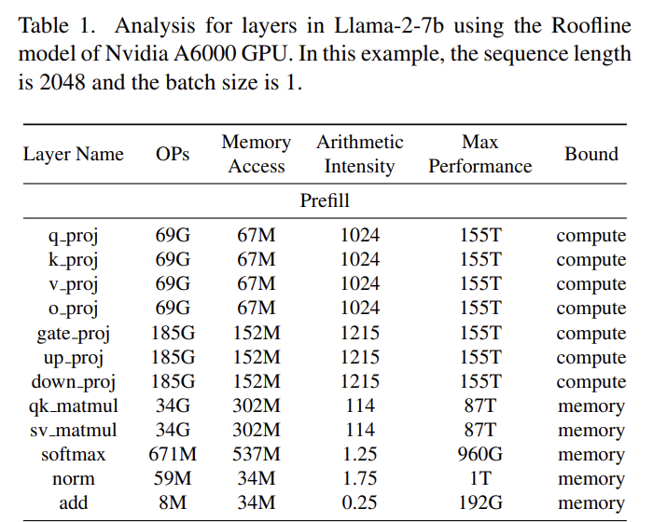


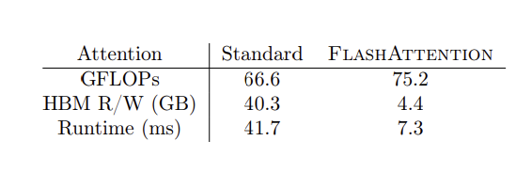
Benefits of The Proposed Dataflow Scheduling for MHA
Make Attention Compute Bound:
We leverage the on-chip Mem resources with explicit SW management and NoC collective operations, we can:
Buffer whole attention matrix on-chip
Fully fusing QK_matmul, SoftMax, SV_matmul kernels
Memory bound -> compute bound
Could even better than FlashAttention
FlashAttetion is still Memory bound on A100
SoftHier Arch has similar on-chip mem and HBM BW vs A100
On A100 GPU -> Peak CUDA core perf = 6912 GFLOPS

Slide 27
We Still Need Some HW Extensions on SoftHier
HW Extension in Progress:
Matrix Transpose Solution:
1. Matrix Transpose engine in each cluster
2. DMA transpose load/store
3. Extend to RedMule to support storing the transposed output matrix.
Vector Engine in Cluster
For vector operations in SoftMax (max, sum, exp).
NoC support for collective operations
Broadcast and Reduction

Slide 28
SoftHier Progress Update
Thomas Benz tbenz@iis.ee.ethz.ch

Slide 29
Overall Update
DMA transposition engine
2 different RTL versions available
Standalone
Cluster-local
Modeling in GVSoC to evaluate best configuration
RTL synthesis and model creation of key interconnect components
Start with iDMA model
Work ongoing
Expand RTL/model to >1024-bit-wide buses
Once successful:
Transposition engine and cluster model
FlooNoC model

Slide 30
SoftHier Progress Update
Luca Colagrande colluca@iis.ee.ethz.ch

Slide 31
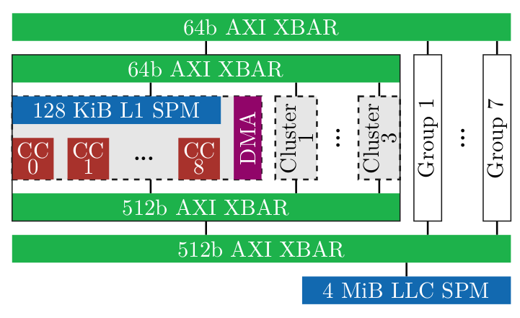
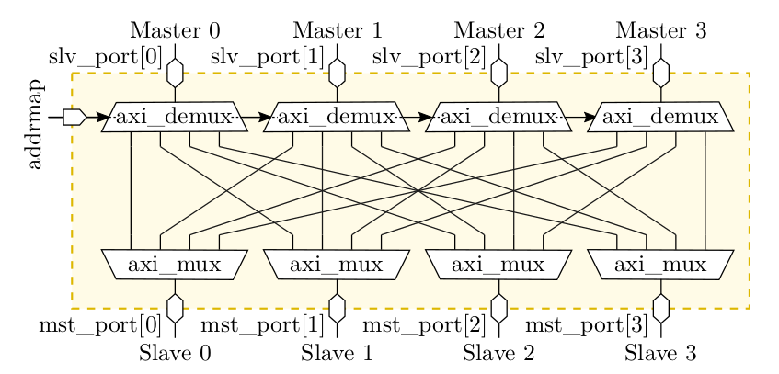
Multicast in Occamy - Design
Typical accelerator memory hierarchy
DRAM -> LLC -> Cluster L1 -> L0 (RegFile)
Occamy interconnect
Tree-like topology: hierarchy of XBARs
Degree of each node
Cluster XBARs: 4
Inter-group XBAR: 8
Multicast-capable interconnect design
Extend XBAR demux to activate lines to different muxes simultaneously
AXI AW and W transactions are forked at the demux
AXI B responses are merged at the demux
Multicast use in Occamy
Cluster DMA transfers
Read from LLC, write to every cluster’s L1 in parallel
Multicast interrupts for synchronization

Slide 32
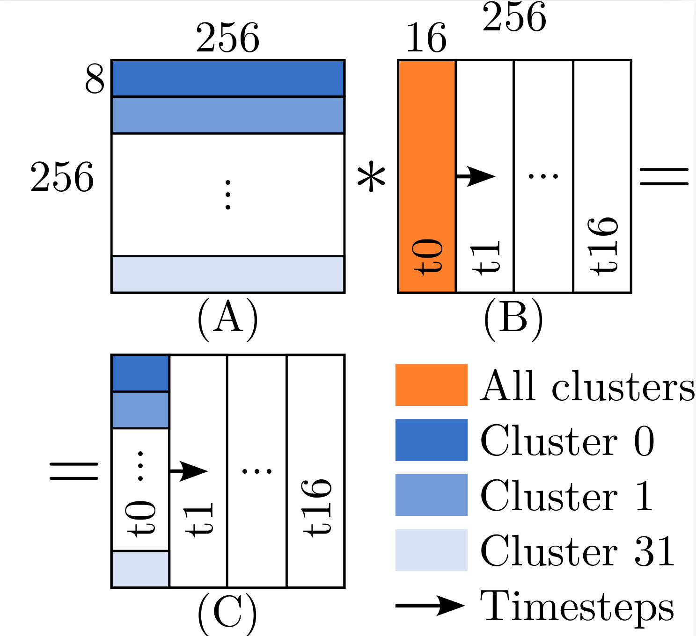
Multicast in Occamy - Matmul
Problem size
Largest square GEMM tile in 4MiB LLC
256x256x256 (considering double-buffering)
Parallelization
Clusters compute different row blocks of C
32 clusters → 8x256 row blocks
Embarrassingly parallel
Every cluster consumes distinct row blocks of A
All clusters consume B
Scheduling
Tile to fit in cluster L1
8x256x16 problem size (considering double-buffering)
Calculate an 8x16 tile of the output row block at a time
8x256 row block of A loaded in first iteration
256x16 column block of B loaded in every iteration

Slide 33
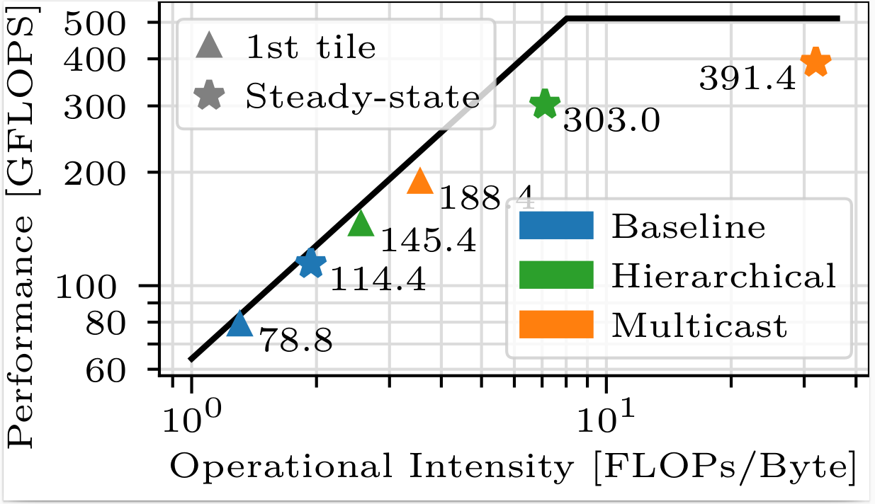
Multicast in Occamy - Results
Compare 3 implementations
Baseline: all clusters load B from LLC
Hierarchical: one cluster per group loads B from LLC, other clusters within group take it from first cluster
Multicast: B is loaded once from LLC and broadcast to all clusters
Baseline is memory-bound
Operational intensity is low, as every cluster loads B from LLC
In this case, multicast can improve performance
By improving operational intensity (OI), as data is loaded once, but reused across clusters
Hierarchical: 3.7x higher OI, 2.6x speedup
Multicast: 16.5x higher OI, 3.4x speedup

Slide 34
Takeaways for SoftHier
Multicast beneficial only if memory-bound
Also as an alternative (cheaper?) solution to e.g. wider links
Benefit can be estimated by simple roofline analysis
Benefit depends on replication factor
Depends on degree of nodes in the network
High-radix tree topologies benefit most

Slide 36
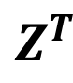
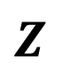
Appendix 1. Support Transposition Store in RedMule
From
TCDM
X Buffer
RedMule
CE array
Tranposed Store
To TCDM
Z Buffer
From
TCDM
W Buffer
$$Z$$
$$Z^{T}$$
To SYNC NoC Router
To DATA NoC Router
HBM
Infinite Instruction Mem
R
R
R
R
C
C
C
C
CTRL
REG
Core 0
RedMule
iDMA
Core 0
C
C
C
C
…
R
R
R
R
Core n
HBM
Interconnect
C
C
C
C
R
R
R
R
TCDM
C
C
C
C
R
R
R
R
Cluster

Slide 37
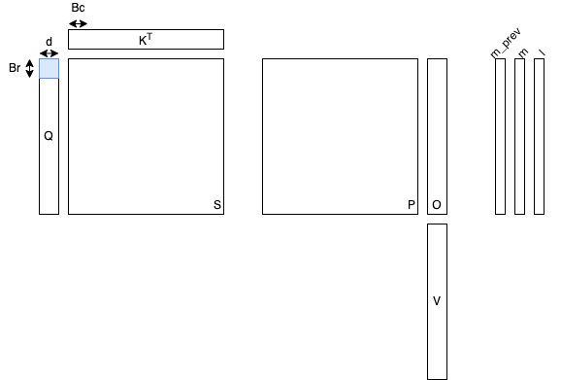
Appendix2. FlashAttention

Slide 38
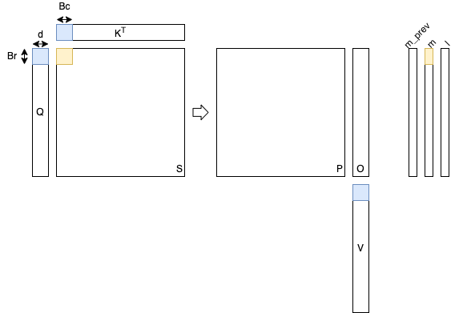
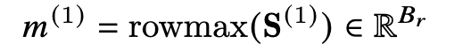
Attention Matrix + Softmax (Inner 1)

Slide 39
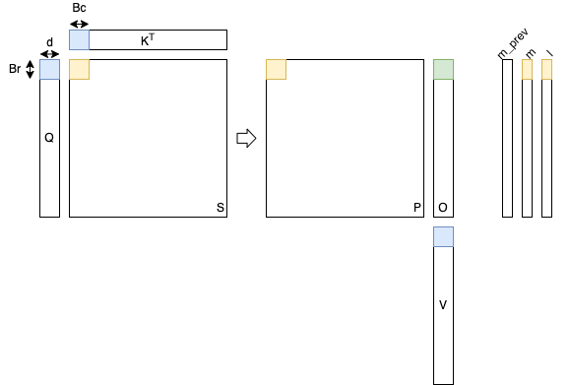
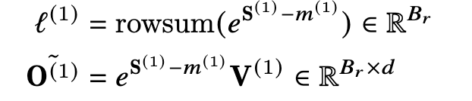
Attention Matrix + Softmax (2)

Slide 40
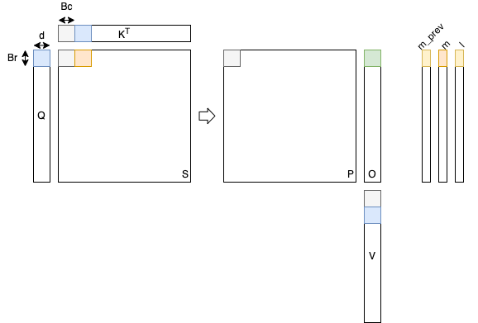
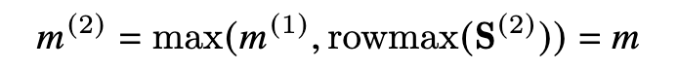
Attention Matrix + Softmax (Inner 3)

Slide 41
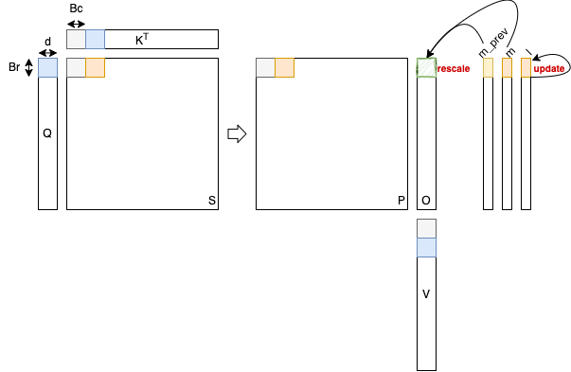
Attention Matrix + Softmax (Inner 4)

Slide 42
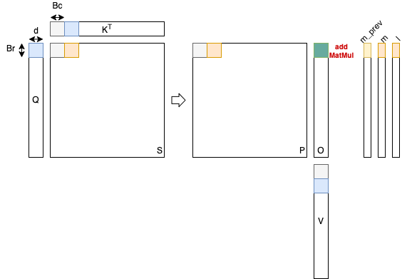
Attention Matrix + Softmax (Inner 5)

Slide 43
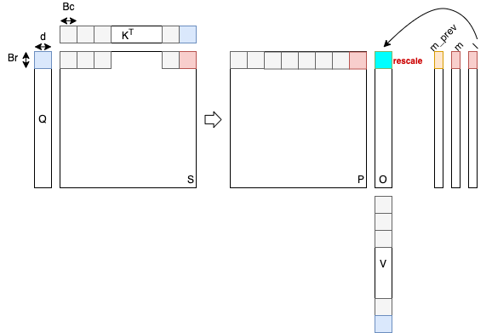
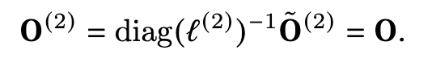
Attention Matrix + Softmax (Outer 2)

